Slide 1
Discovery
Scott Klemmer tas: Amal Dar Aziz, Mike Krieger, Ranjitha Kumar, Steve Marmon, Neema Moraveji, Neil Patel
30 September 2008

Slide 2
“You Can Learn a Lot Just by Watching”
—Yogi Berra

Slide 3
Today
Approach
Doing Observational Work
Announcements & Questions

Slide 4
APPROACH

Slide 5
Variety of observation techniques
Contextual inquiry
Ethnography
Diary studies
Prompted (pager) studies
Cultural probes
Task analysis

Slide 6
ETHNOGRAPHY
Anthropology
The social science that studies the origins and social relationships of human beings
The branch of anthropology that provides scientific description of individual human societies
Notes:
Writing about Culture
Began with “other” cultures, moved to our own

Slide 7
Goals
Natural
Holistic
Descriptive

Slide 8
The Practical Logic of the Everyday World
Notes:
What sociologists do is not categorically different than what we do in everyday life; the only different is that sociologists are more reflective about it
(in contrast with focus groups)

Slide 9
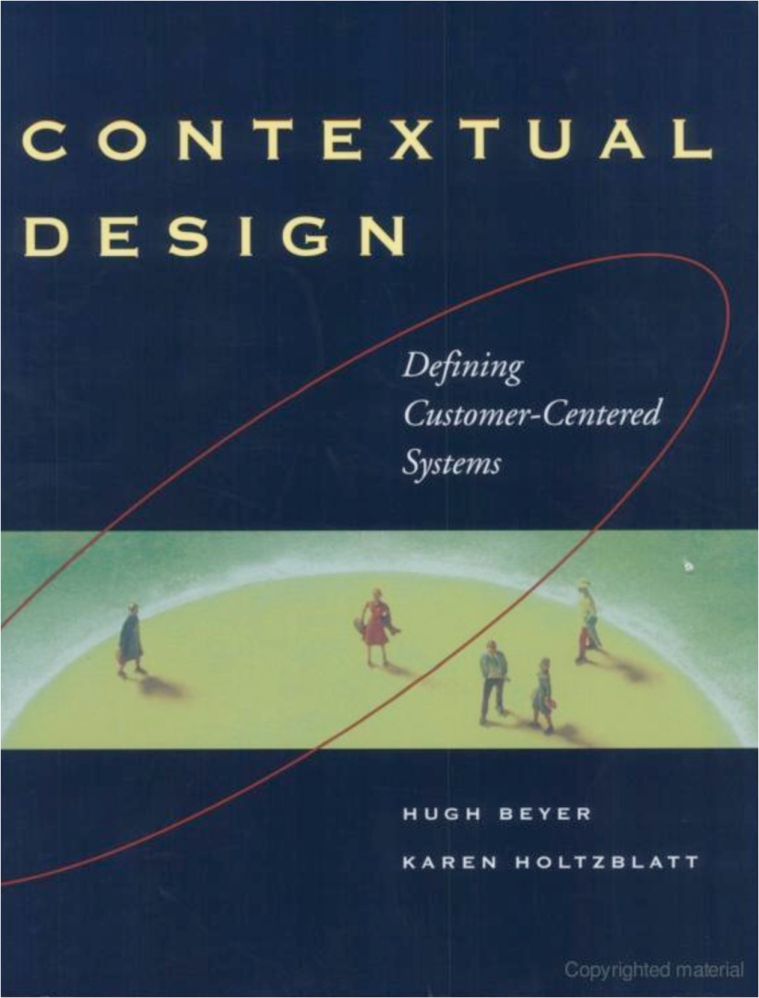
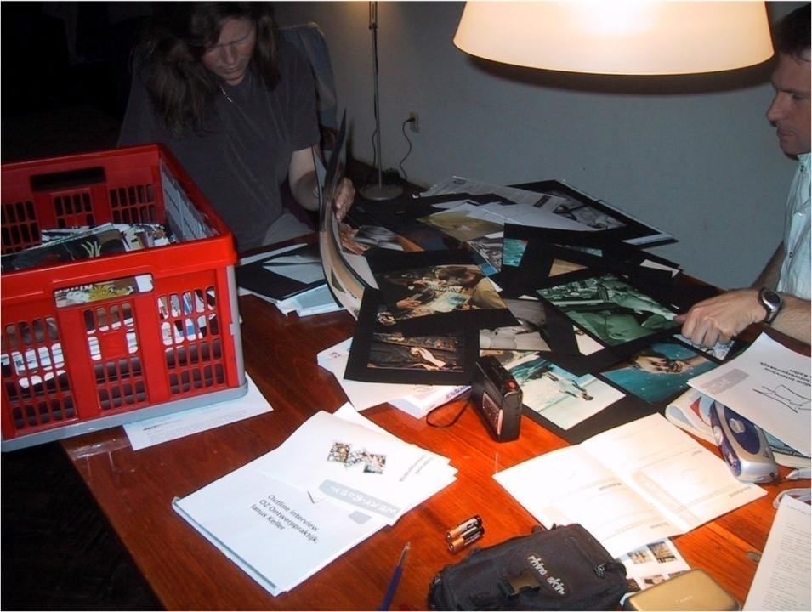
More about Contextual Inquiry
Collections Designers Keep. Contextual
Inquiry of designers in NL. Tu Delft.
ID-StudioLab
Source: Beyer, Hugh, Karen Holtzblatt. Contextual Design: Defining Customer-Centered Systems. Morgan Kaufmann, 1997.

Slide 10
What is Context?
Activity in its actual place
Artifacts and tools
The ecology around it

Slide 11
How to perform Contextual Inquiry?
Set up a partnership with the people to be observed
Be taught the steps in the process
Observe all of the practices
Validate what you are observing with those observed as you go along

Slide 12
How to record a contextual inquiry
Notes
Camera
Action

Slide 13
Discovery is the root of design
Discovery
Exploration
Refinement
Production

Slide 14
Observation is at the heart of Discovery
Set goals
Observe
Synthesize

Slide 15
The Discovery process yields …
What users do now
What values do the users have
How the users activities are embedded in an overall “ecology”

Slide 16
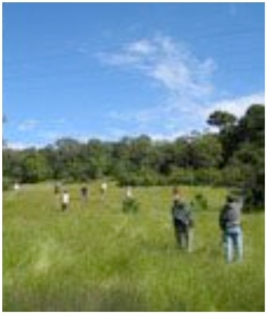
Don’t just observe process, observe the practice
Practice
A thousand word picture
Process
Step one
Step two
Step three
Ask Why’s?

Slide 17
Process v. Practice Jack Whalen & the Call Center

Slide 18
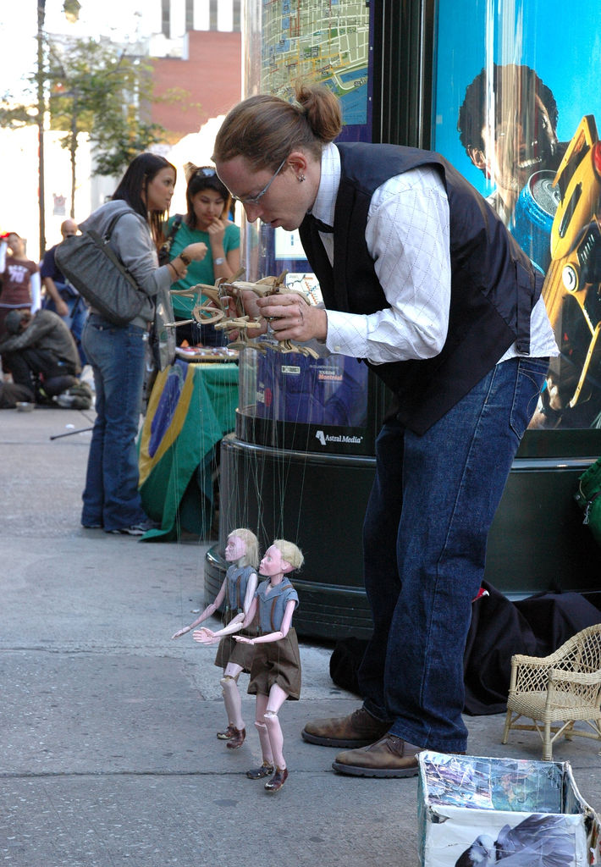
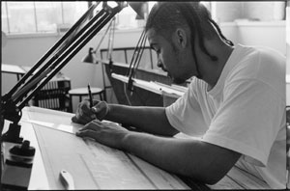
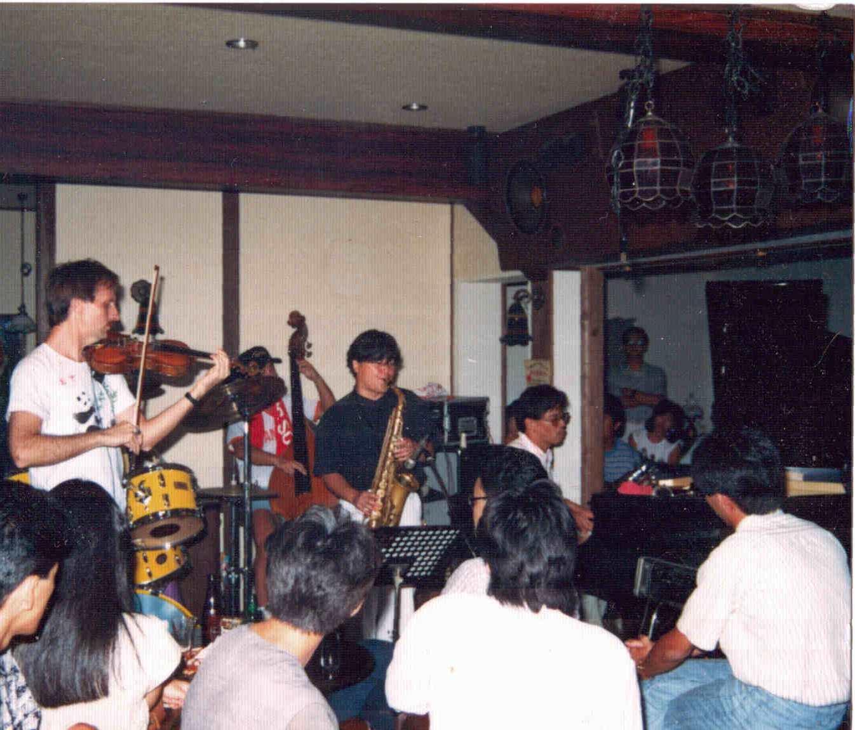
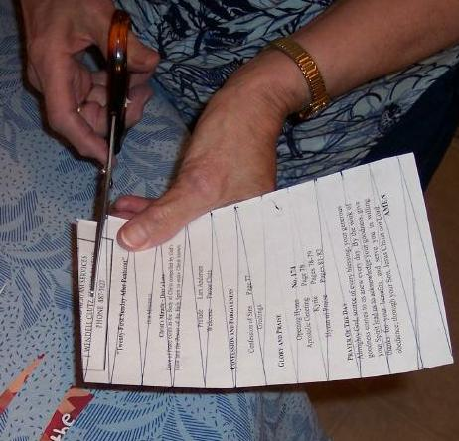
Tacit Knowledge
Notes:
A collegiate basketball player shooting hoops; an architect at a drafting table; a crafter cutting pieces of paper and a musical band in concert– these are a few examples of the complex, actions people perform.
And in many cases, these physical action can be both faster and more nuanced than symbolic cognition.
One of the most powerful human capabilities is the intimate incorporation of an artifact into their practice to the point where people perceive that artifact as an extension of themselves: they act through it rather than on it
The crafter cuts the paper through the scissors; without focusing on her actions upon the handles of the scissors The violin virtuoso expresses himself through the violin, not on the fingerboard and bow. The puppeteer feels the ground underneath his puppet’s feet, not the controls in his hands.
Polanyi termed this incorporation tacit knowledge and it lies at the core of skillful action.

Slide 19
“That’s Obvious!”

Slide 20
Deep Hanging Out

Slide 21
A Shifting Landscape

Slide 22
DOING OBSERVATION

Slide 23
Makes Explicit Much of What Good Design Does Implicitly
Notes:
I don’t intend to be formulaic (Don Norman’s anecdote about business books)

Slide 24
The Importance of Being Curious
Notes:
CS270
As opposed to “being vacant”

Slide 25
DESIGN IS ABOUT CHOICE
Notes:
GOOD CHOICE COUNTS A LOT ESPECIALLY AT THE BEGINNING OF THE PROJECT
Pick a good environment, and you’ll have a good problem

Slide 26
“Does your employer or his representative resort to trickery in order to defraud you of your earnings?”

Slide 27
“Is the daily update an important feature to you?”
Notes:
How about “What are your thoughts about the daily update”
If this sounds a bit like psychoanalysis, well, …

Slide 28
GOOD QUESTIONS
Are open-ended
Avoid Binary Questions
Let Silence Happen

Slide 29
Erring in the Other Direction…
“Tell me a story about yourself”
Notes:
This rarely works, as most of us don’t have an index
If it does yield a response, You’ll just get something that’s rehearsed

Slide 30
Plans are useless, planning is invaluable

Slide 31
PAY ATTENTION TO ARTIFACTS

Slide 32
Say you were designing…
A lecture support system
Here are my steps

Slide 33
Finding People…
Notes:
Is Hard
& scary
Joel’s going to Adobe MAX

Slide 34
What people can’t tell you…
Functional fixedness: People understand their world within a structure that imposes limitations. It's hard to see outside that structure.
What they would do / like / want in hypothetical scenarios
How often they do things
The last time they did something
How much they like things on an absolute scale
So, you cannot simply ask people what features they would like in a tool.

Slide 35
What people can tell you…
What they “generally” do
How they do it
Their opinions about their current activities
Their complaints about their current activities
How much they like one thing compared with another

Slide 36
Creating an interview protocol
Figure out who to interview
Structuring the interview
Start with demographics, overall goals, high-level tasks, company policies, etc.
Move on to more open-ended questions (have them walk you through a task/day, what works well, what doesn’t?)
Cycle back to more detailed questions

Slide 37
Interviewing tips
Introduce yourself, explain your purpose
The interview is about them, not you!
Ask open, unbiased questions
Ask the question and let them answer
Follow up
Adjust your questions to their previous answers
Ask questions in language they (use) understand
Pick up on and ask for examples
Be flexible

Slide 38
Who’s doing all the talking
Strive for about 20% (or less!)

Slide 39
Recording the interview
Interview in pairs
One person interviews, the other takes notes & listens
Audiotaping
Accurate record of the interview
Great for mining lots of information per interview -- your notes will never be as complete
Helpful if impressions change as you interview others
Tedious to review later (but well worth it)
Helpful for presentations - makes the people real
Get permission in advance - be aware of security issues

Slide 40
Recording the interview
Videotaping
Same advantages and disadvantages as audiotape
Even better for communicating findings to others
May be harder to get permission
More issues of confidentiality
May make people less willing to divulge sensitive information
If you can't videotape, take snapshots

Slide 41
Where should you interview?
In their setting (i.e. their office, home, car, etc.)
Gives you much better insight into their activities
Gives you a chance to see their environment
Allows them to show you rather than tell you
If not possible to interview in their setting, ask for a tour before or after

Slide 42
Before you go…
Take a trial run with colleagues or friends
Gives you practice interviewing
Irons out problems with the questionnaire, redundancies, inconsistencies

Slide 43
After the Interviews
Keep photos and other concrete details around
Concrete people help tie all design to use, rather than debating things on an abstract plane

Slide 44
WWMPD?

Slide 45
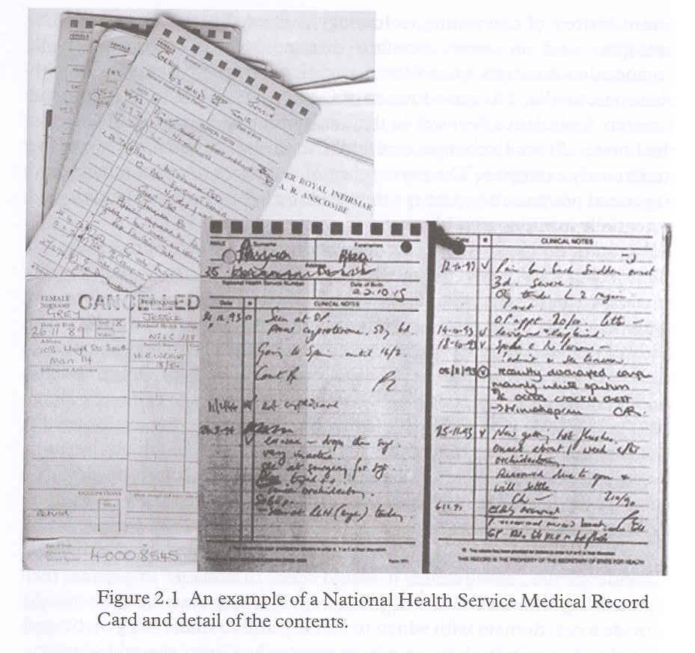
thick practice
Medical Records
Notes:
interfaces that are the real world can obviate many of the difficulties of attempting to model all of the salient characteristics of a work process as practiced. This argument builds on Weiser’s exhortation to design for “embodied virtuality” rather than virtual reality [72]. Designing interactions that are the real world instead of ones that simulate or replicate it hedges against simula-cra that have neglected an important practice.

Slide 46
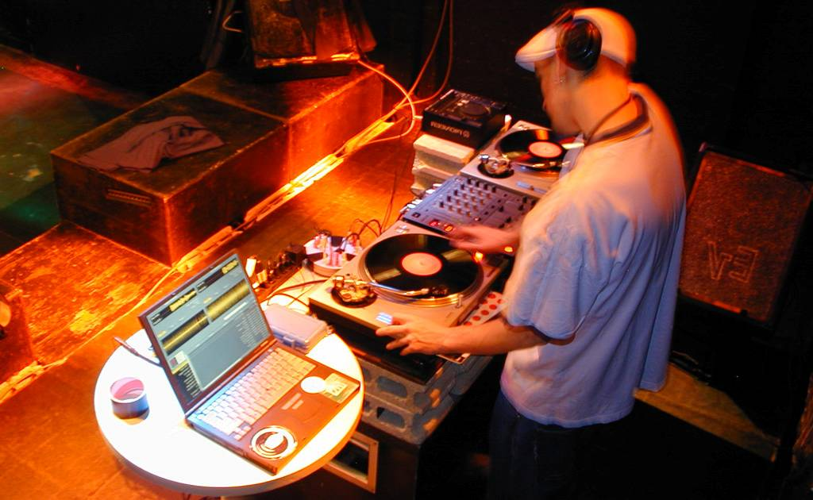
Final Scratch
thick practice
Notes:
This is a picture I took in my prior life as a touring DJ.
You can see my label partner behind the interface of choice of professional DJs worldwide: Two Technics turntables a
What is the laptop doing in the picture?
It is running Final Scratch
FinalScratch affords continuity of practice — skills acquired over years of practice still apply since the physical interface has not changed.
Notice the gaze

Slide 47
Field Biology
thick practice
Notes:
* interviewed 23 biologists
* joined a field research class in the Los Tuxtlas rainforest
* became a docent at Jasper Ridge
* comprises 370 hours of observing, talking to, and working with field biologists, with observations captured on photographs, audio, and video.
* Finally, an ecologist collaborated on this research.

Slide 48
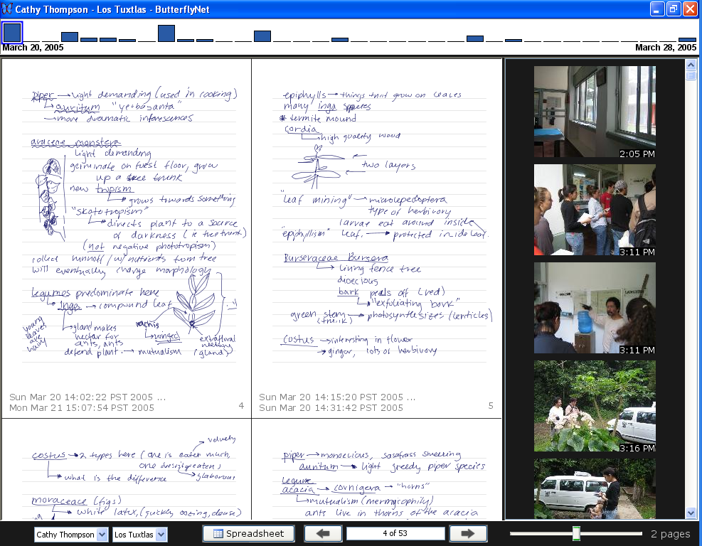
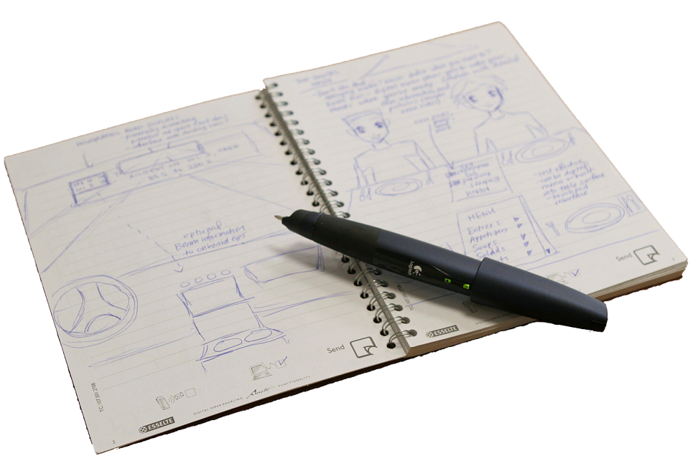
ButterflyNet
thick practice
chi 2006

Slide 49
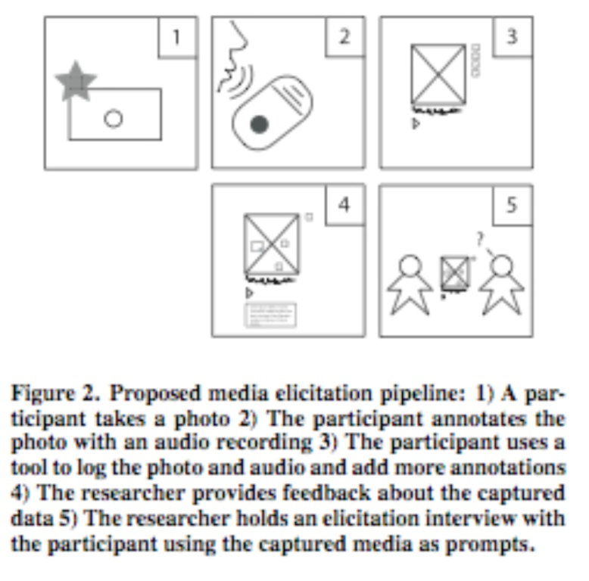
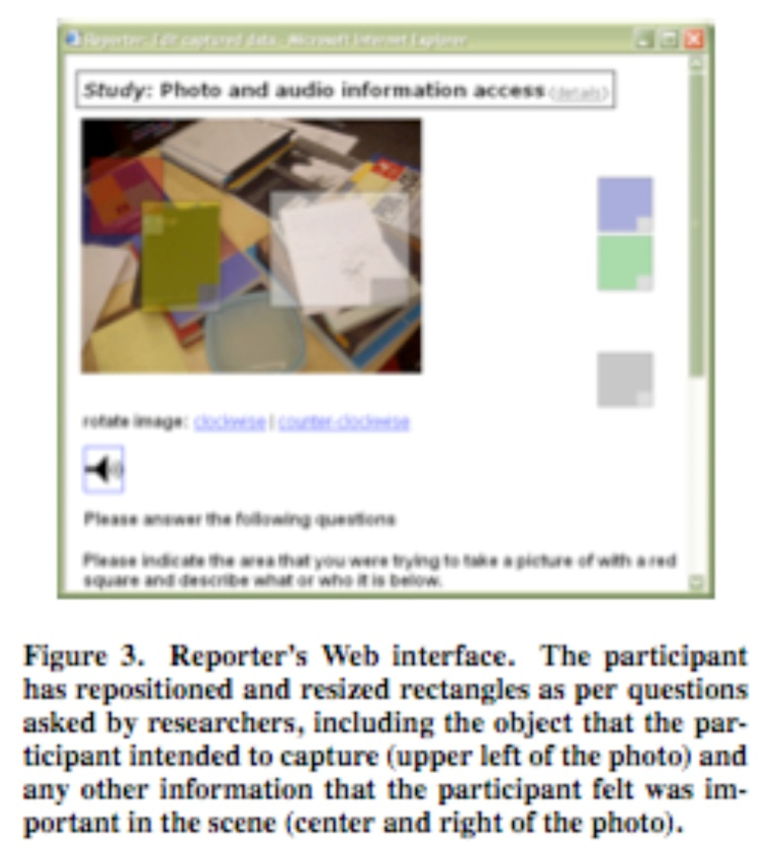
Eye to future: in situ diary studies
Source: Carter, S. and J. Mankoff. When Participants Do the Capturing: The Role of Media in Diary Studies. Proceedings of the ACM Conference on Human Factors in Computing Systems (CHI), Pages: 899-908. 2005.

Slide 50
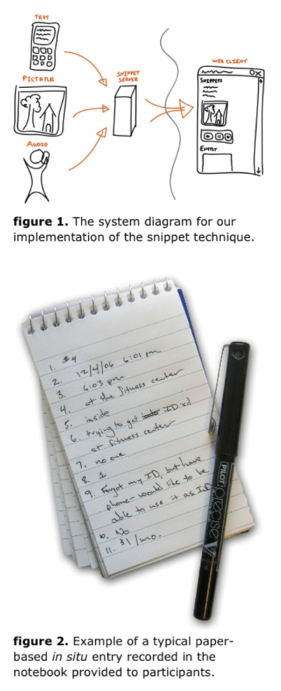
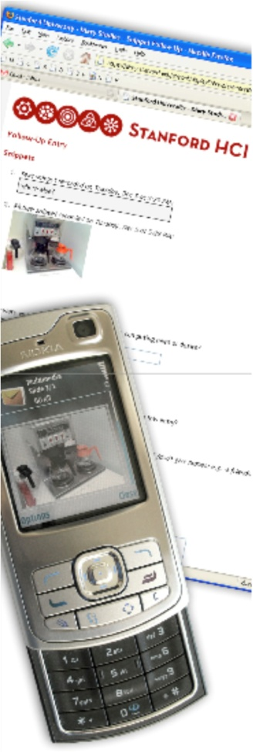
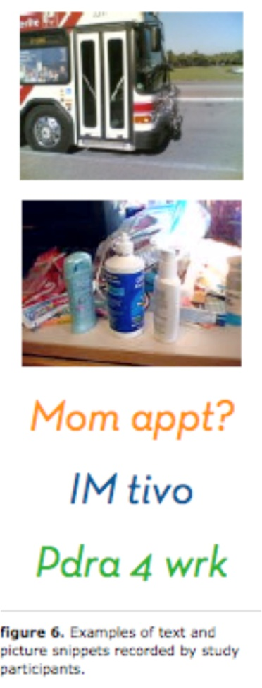
Eye to future: txt 4 l8r
Source: Joel Brandt, Noah Weiss, and Scott R. Klemmer. txt 4 l8r: Lowering the Burden for Diary Studies Under Mobile Conditions. Work-in-progress, ACM Conference on Human
Factors in Computing Systems (CHI), San Jose, California. 2007

Slide 51
Questions
About the assignment
About studio today & tomorrow
About class in general

Slide 52
Further Reading
Mike Kuniavsky, Observing the User Experience
Beyer and Holtzblatt, Contextual Design
Jeanette Blomberg
Paul Dourish
Diana Forsythe, “It’s just a matter of common sense”

